Slide 1
Global PSP Project for Indian Embassies and Consulates
Quick Guide – Search Application Screen

Slide 2
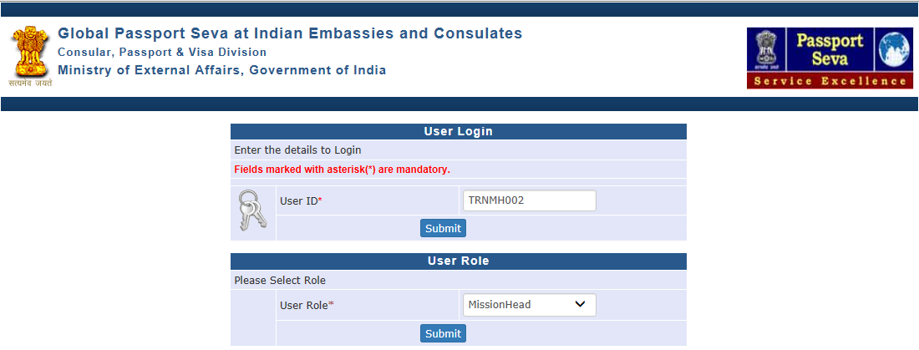
Login Using User ID, Password, and Grid Values
Visit Global PSP Office Portal (https://embassy.passportindia.gov.in)
Enter User ID
Press Submit button
Choose User Role
Press Submit button displayed below the User Role

Slide 3
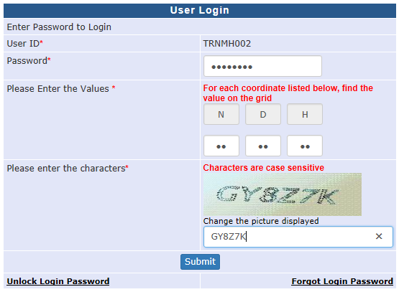
Login Using User ID, Password, and Grid Values (continued..)
Enter Password
Check your User Grid and enter the values for the three alphabets displayed on the screen
Enter the characters displayed in the CAPTCHA image
Press Submit button

Slide 4
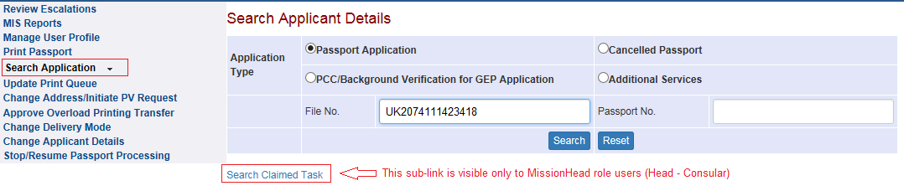
Search Application Screen
Click on the Link ‘Search Application’ displayed in the Vertical Menu
Enter File Number or Passport Number to fetch corresponding application details (details can be fetched for applications of any Indian Mission/Post abroad or of an RPO in India)
Press Search button

Slide 5
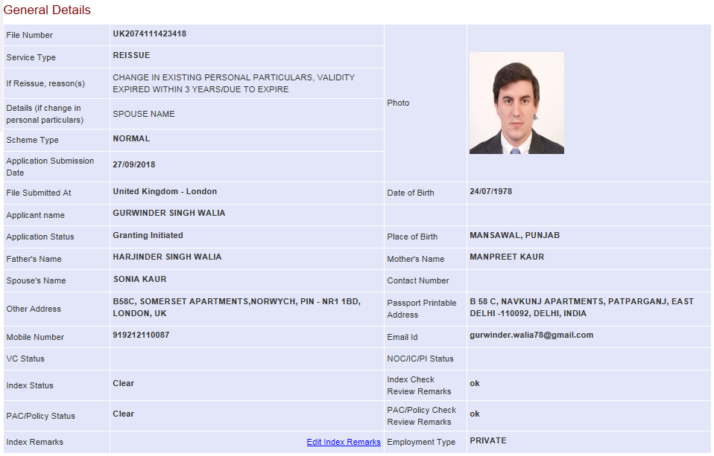
Search Application Screen (continued..)
General Details about the application are displayed on top

Slide 6
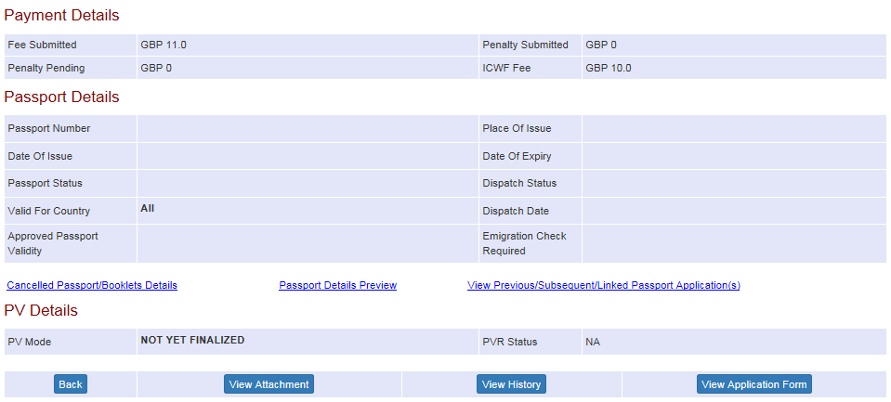
Search Application Screen (continued..)
Payment, Passport and Police Verification details are displayed below the General Details

Slide 7
Viewing Application Processing History

Slide 8
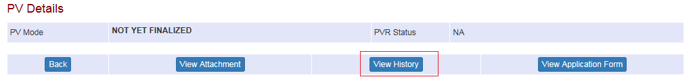
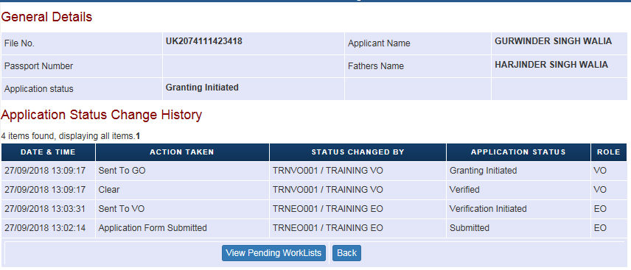
Viewing Application Processing History
Click on the View History button to see the major application processing activities displayed in chronological order

Slide 9
Viewing Attachment and Remarks

Slide 10
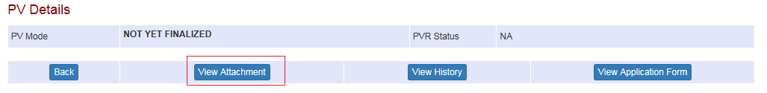
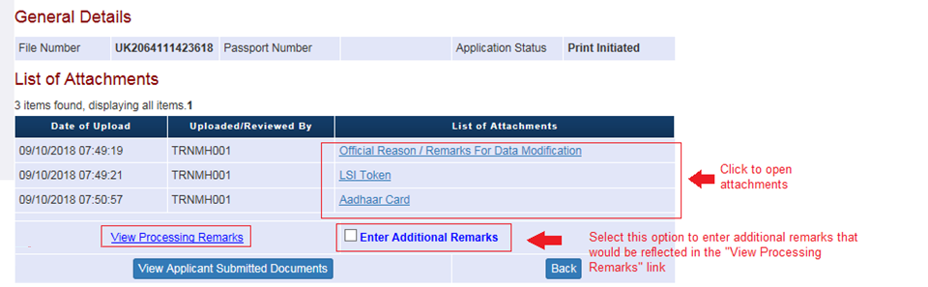
Viewing Attachment and Remarks
Click on the View Attachment button to see the documents and remarks
Click on View Processing Remarks link to see all remarks entered for the application
Click on Enter Additional Remarks link to add remarks that would be reflected under View Processing Remarks link

Slide 11
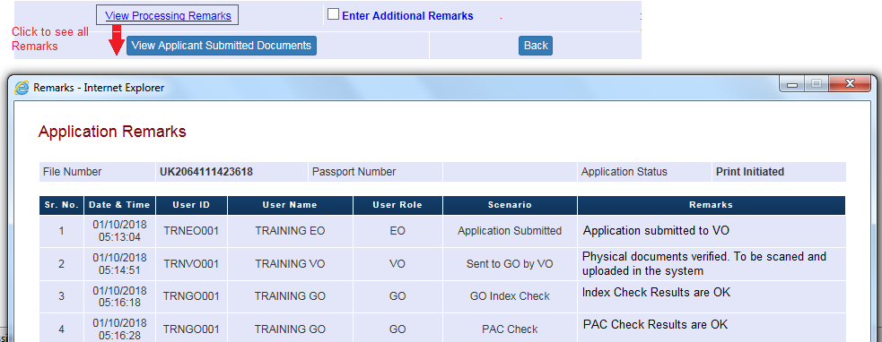
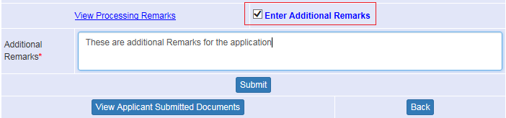
Viewing Attachment and Remarks (continued..)

Slide 12
Viewing Application Form

Slide 13
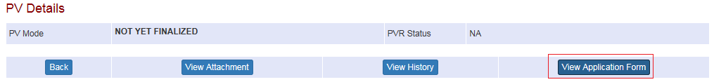
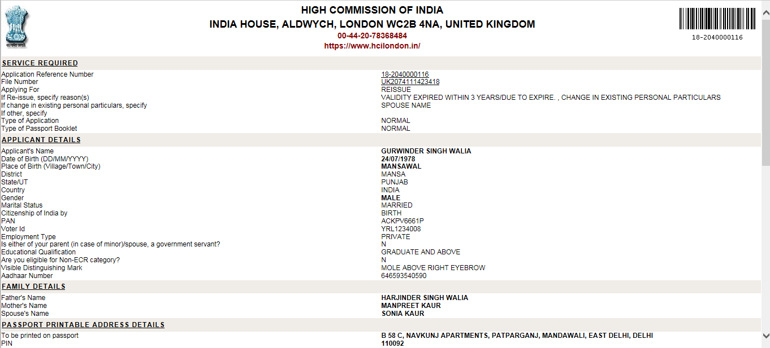
Viewing Application Form
1. Click on the View Application Form button to view the application form details

Slide 14
Viewing Claimed Work-items (feature only available to MissionHead role Users)

Slide 15
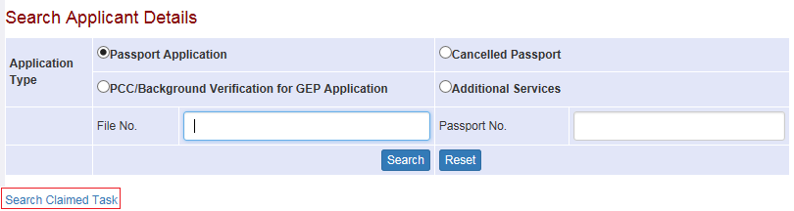
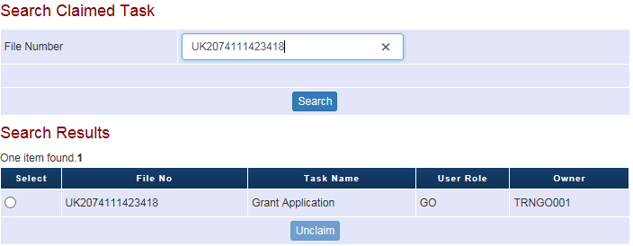
Viewing Claimed Work-items
Click on the Link ‘Search Application’ displayed in the Vertical Menu
Click on the Search Claimed Task hyperlink displayed at bottom
Enter File Number and press Search button to view the work-items
To un claim a work-item, select the same and press Unclaim button

Slide 16
In case of additional information or clarification, please contact Global PSP Support Team at
Email : global.psp@tcs.com
Phone : +91-0120-672-9595/96
Mobile : +91-730-351-9595
Thank You

